Slide 1

Designing a Secure Shopping Cart and Order Management System
-Subathira Shri Devi R

Slide 2
Title
Title: Shopping Cart System and Order Management System
Subtitle: Browse and Purchase System

Slide 3
Project Overview
Overview:
A system allowing browse products, add to cart, and place orders.
Technologies Used:
Python with Tkinter for the user interface.
MySQL for storing user data, products, orders, and order items.

Slide 4
Database Structure Overview
Database:
MySQL used to store product and user information.
Key Tables:
products: Stores product details.
orders: Stores order details.
order_items: Stores details about products in an order.

Slide 5
MySQL Database Setup -Products Table
Table Structure:
Fields:
id: Primary key.
name: Product name.
price: Product price.
category: Product category (e.g., Electronics, Clothing).
CREATE TABLE products (
id INT AUTO_INCREMENT PRIMARY KEY,
name VARCHAR(255) NOT NULL,
price DECIMAL(10, 2) NOT NULL,
category VARCHAR(100)
);

Slide 6
MySQL Database Setup - Orders Table
Table Structure:
Fields:
id: Primary key.
user_name: Name of the user who placed the order.
address: Shipping address.
total_price: Total cost of the order.
CREATE TABLE orders (
id INT AUTO_INCREMENT PRIMARY KEY,
user_name VARCHAR(255),
address TEXT,
total_price DECIMAL(10, 2),
order_date TIMESTAMP DEFAULT CURRENT_TIMESTAMP
);

Slide 7
MySQL Database Setup - Order Items Table
Table Structure:
Fields:
id: Primary key.
order_id: Foreign key linking to the orders table.
product_id: Foreign key linking to the products table.
quantity: Quantity of the product ordered.
CREATE TABLE order_items (
id INT AUTO_INCREMENT PRIMARY KEY,
order_id INT NOT NULL,
product_id INT NOT NULL,
quantity INT NOT NULL,
FOREIGN KEY (order_id) REFERENCES orders(id),
FOREIGN KEY (product_id) REFERENCES products(id)
);

Slide 8
Program Initialization
Database Connection:Establish connection to MySQL database using mysql-connector.If connection is successful, print message. If not, show error.
def get_db_connection():
try:
conn = mysql.connector.connect(
host="localhost",
user="root",
password="admin",
database="shopping_cart"
)
print("Database connection successful")
return conn
except mysql.connector.Error as err:
messagebox.showerror("Database Error", f"Error connecting to the database: {err}")
return None

Slide 9
def show_purchase_window(username):
purchase_window = tk.Tk()
purchase_window.title("Purchase Page")
purchase_window.geometry("400x300")
purchase_window.configure(bg="#f4f4f4")
label_welcome = tk.Label(purchase_window, text=f"Welcome, {username}!", font=("Helvetica", 16), bg="#f4f4f4")
label_welcome.pack(pady=20)
label_purchase = tk.Label(purchase_window, text="This is the professional purchasing page.", font=("Helvetica", 12), bg="#f4f4f4")
label_purchase.pack(pady=10)
btn_order1 = tk.Button(purchase_window, text="Order Item 1", font=("Helvetica", 12), width=15)
btn_order1.pack(pady=5)
btn_order2 = tk.Button(purchase_window, text="Order Item 2", font=("Helvetica", 12), width=15)
btn_order2.pack(pady=5)
btn_logout = tk.Button(purchase_window, text="Logout", command=purchase_window.destroy, font=("Helvetica", 12), bg="#ff6666", fg="white")
btn_logout.pack(pady=20)
purchase_window.mainloop()
Product Browsing in the Purchase Window
Product List:
Display available products in the purchase window.
Example:
Buttons to order specific products.

Slide 10
def place_order(username, product_id, quantity):
conn = get_db_connection()
cursor = conn.cursor()
cursor.execute("SELECT price FROM products WHERE id = %s", (product_id,))
product = cursor.fetchone()
if product:
total_price = product[0] * quantity
cursor.execute('''INSERT INTO orders (user_name, address, total_price)
VALUES (%s, %s, %s)''', (username, "User Address", total_price))
order_id = cursor.lastrowid
cursor.execute('''INSERT INTO order_items (order_id, product_id, quantity)
VALUES (%s, %s, %s)''', (order_id, product_id, quantity))
conn.commit()
conn.close()
Handling Orders and Cart
Cart Logic: When a product is ordered, update the cart (or order items in database).
Order Placement: Link ordered products to the order_items table, calculate the total, and store in orders table.

Slide 11
Checkout Process
User Details: Collect shipping details and finalize the order.
Backend Logic: Create a new order entry in the orders table and associate it with order items.
cursor.execute('INSERT INTO orders (user_name, address, total_price) VALUES (%s, %s, %s)',
(user_name, address, total_price))

Slide 12
Challenges & Solutions
Challenges:User authentication and session management.
Cart management and preventing duplicate entries.
Solutions:Use sessions or cookies for user tracking.
Enforce unique constraints on usernames and product orders.
Example of order creation with foreign keys linking orders and products
cursor.execute('''INSERT INTO order_items (order_id, product_id, quantity)
VALUES (%s, %s, %s)''', (order_id, product_id, quantity))

Slide 13
Future Enhancements
Improvements:
Implement advanced search for products.
Add payment gateway integration (e.g., PayPal, Stripe).
Improve the user interface with additional features (e.g., product categories, order history).

Slide 14
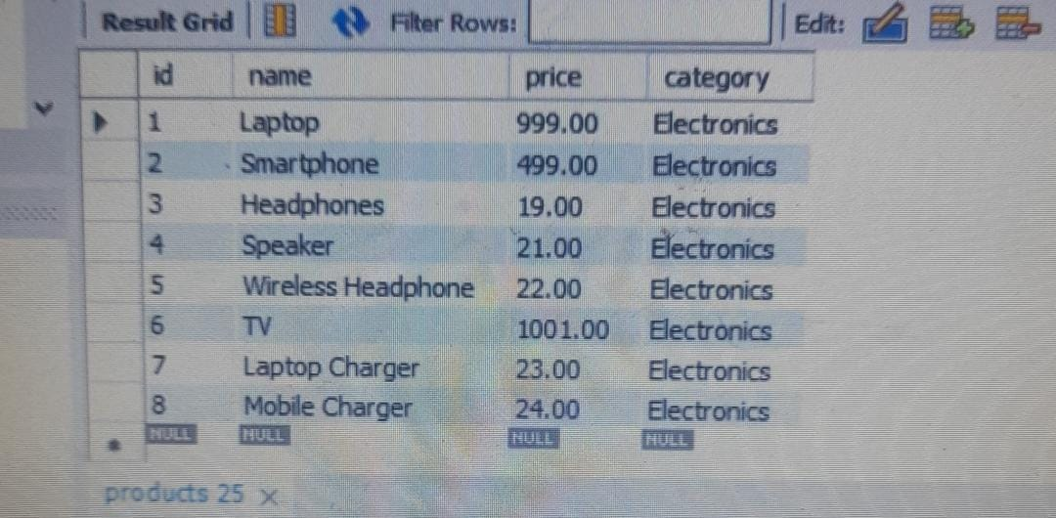
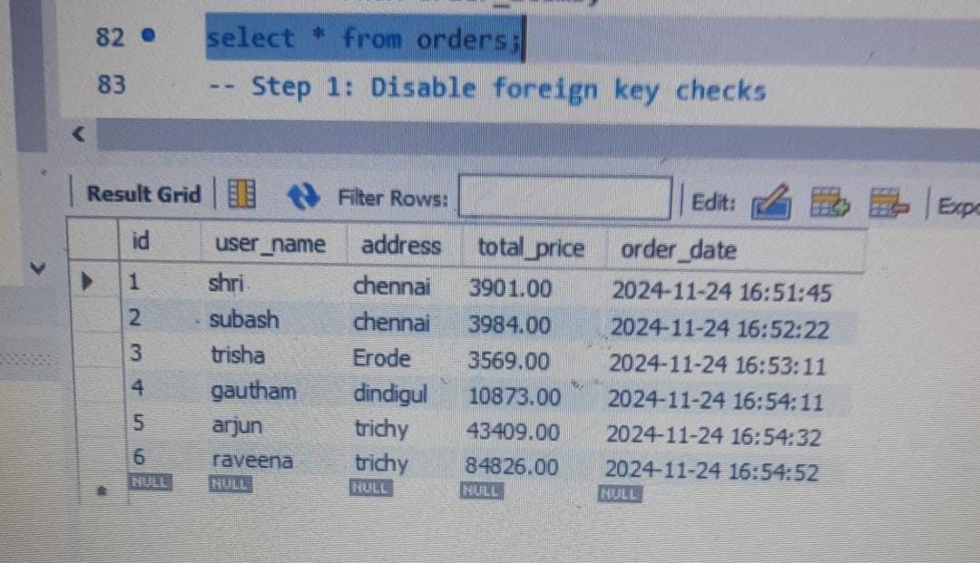
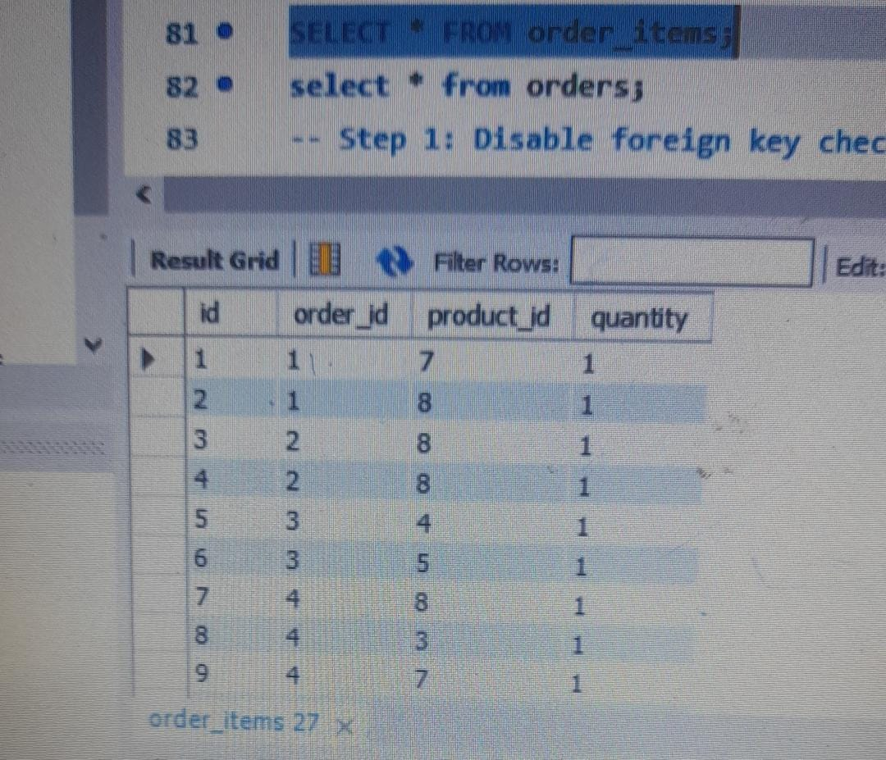
OUTPUT
Select *from products;
Select *from orders;
Select *from order_items;
Where the products to be chosen to buy.
The details of customers and their orders are stored in a databsase.
The ordered items and their quantity get stored in a databse.

Slide 15
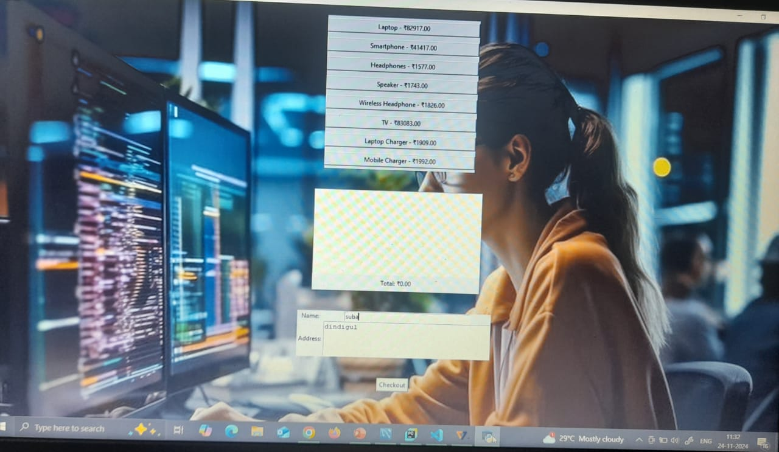
output page

Slide 16
Conclusion
Summary:
The system enables users to register, log in, browse products, and place orders.
Uses Tkinter for the front-end and MySQL for data storage.
The program can be expanded with more features in the future.
Future Goals: Integrating full checkout and payment systems for real-world use.

